Slide 1
Summary of Nanopore 16s exp

Slide 2
Exp - Jan Bilbao Summer 2023 - Samples ID
Barcode # | Sample ID | Barcode # | Sample ID
1, 2, 3 | Young, 5d, 0_EtOH exposition | 10, 11, 12 | Old, 50d, 0_EtOH exposition
4, 5, 6 | Young, 5d, 1_EtOH exposition | 13, 14, 15 | Old, 50d, 1_EtOH exposition
8, 9 | Young, 5d, 2_EtOH exposition | 16, 17, 18 | Old, 50d, 2_EtOH exposition

Slide 3
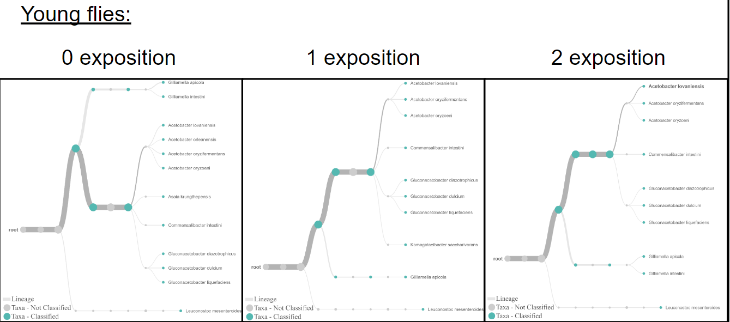
Nanopore 16s - Epi2me

Slide 4

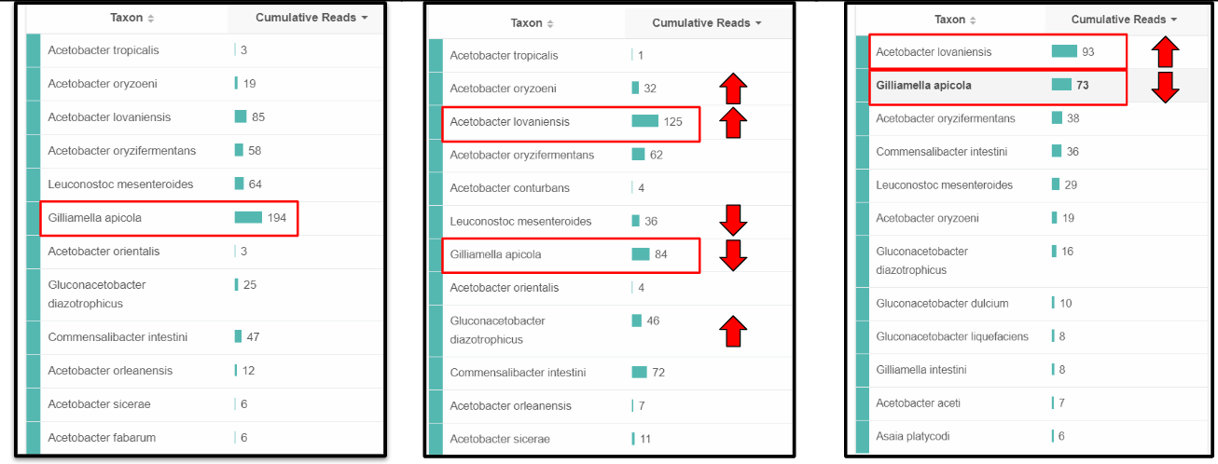
Nanopore 16s - Epi2me

Slide 5
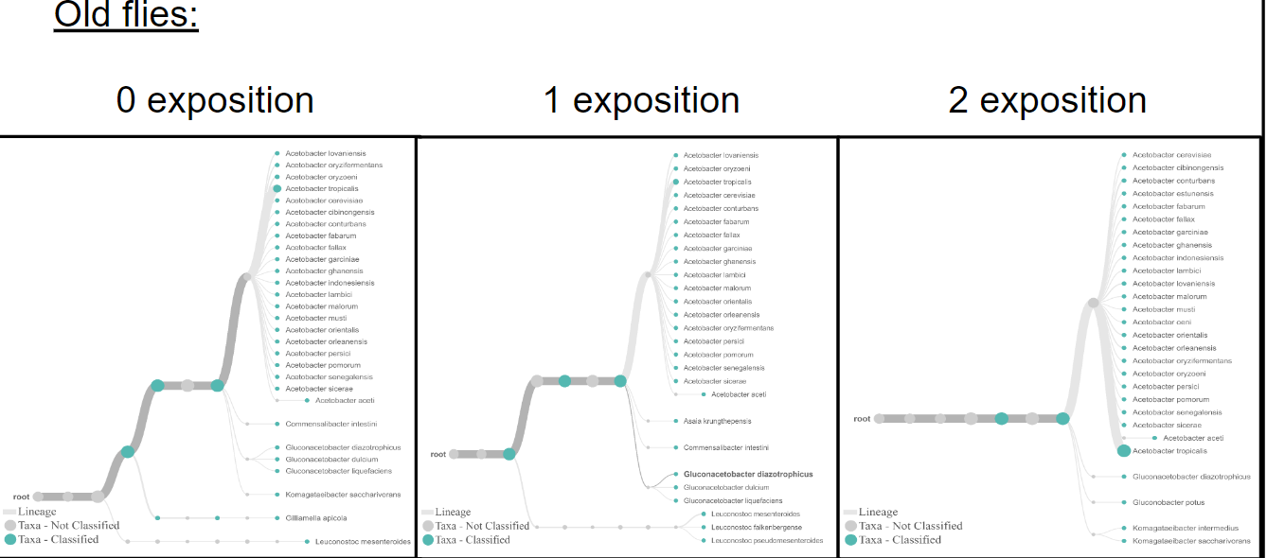
Nanopore 16s - Epi2me

Slide 6

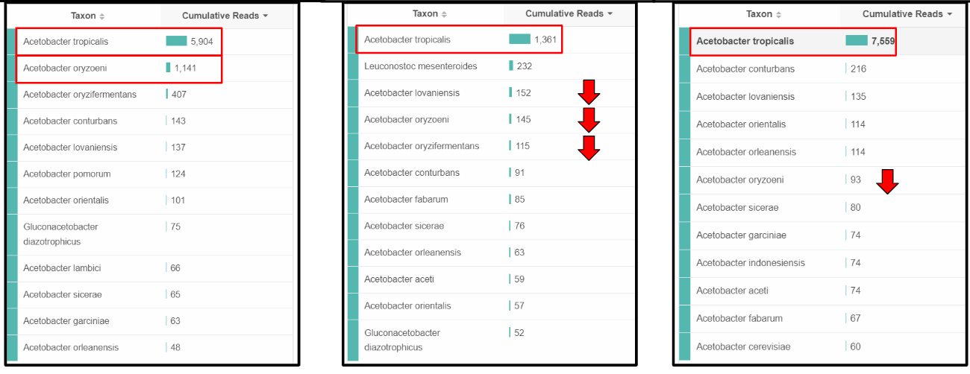
Nanopore 16s - Epi2me

Slide 7
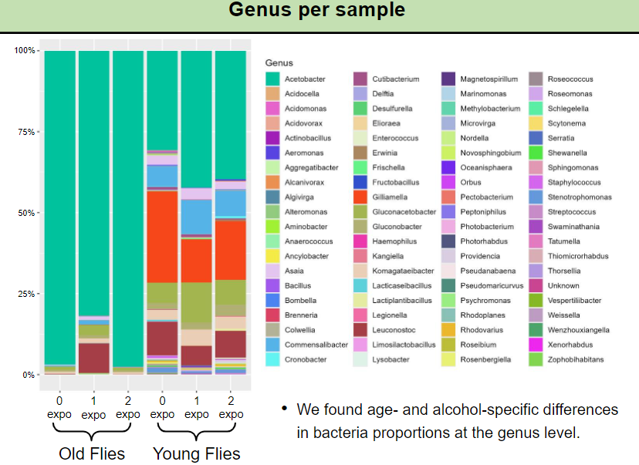
R script

Slide 8
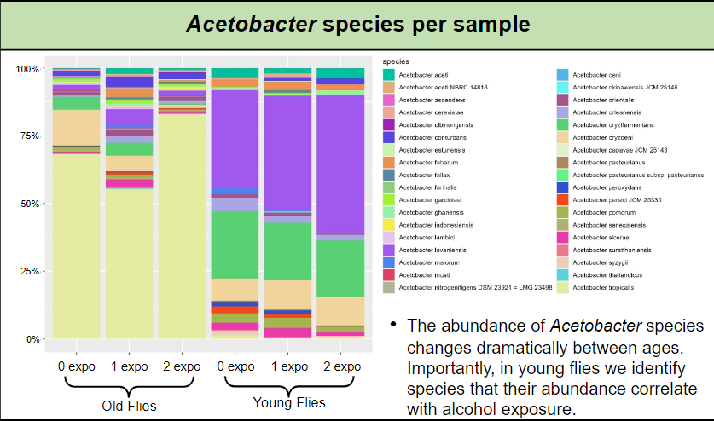
R script

Slide 9
Tentative! Exp - Austen (Summer 2024) - Samples ID
All Young 5 days
Barcode # | Sample ID | Barcode # | Sample ID
1, 2, 3 | Females, 5d, 0_EtOH exposition | 10, 11, 12 | Males, 50d, 0_EtOH exposition
4, 5, 6 | Females, 5d, 1_EtOH exposition | 13, 14, 15 | Males, 50d, 1_EtOH exposition
7, 8, 9 | Females, 5d, 2_EtOH exposition | 16, 17, 18 | Males, 50d, 2_EtOH exposition

Slide 10
Na

